Slide 1

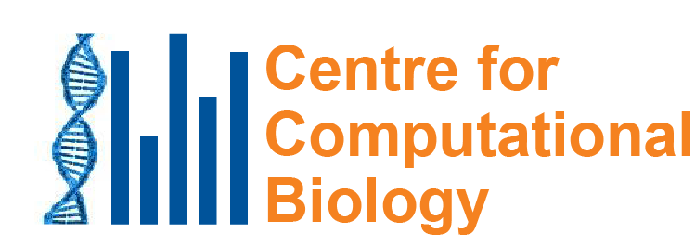
Mutational Signatures Core Concepts in Bioinformatics 2022 Jan 24
Steven G. Rozen
steverozen@pm.me
Notes:
25 minute talk

Slide 2
Context
Discovery
Analysis of large databases
Experimental delineation
Mutational Signatures

Slide 3
Mutational Signatures Context
Discovery
Analysis of large databases
Experimental delineation
Mutational Signatures
Molecular cancer epidemiology
Which mutational processes cause cancer?
Understanding
DNA damage &repair
Public health: prevention and screening
How do cancers develop?
Application
Therapeutic opportunities

Slide 4
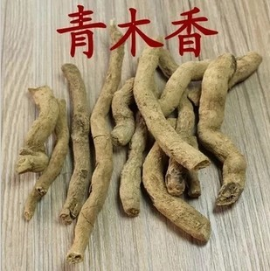
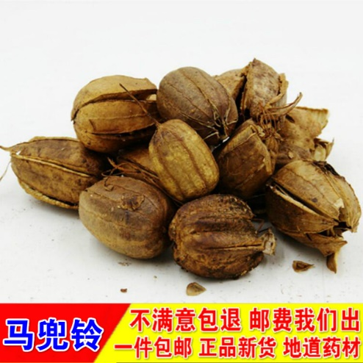
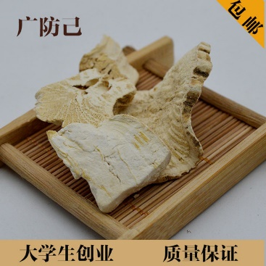
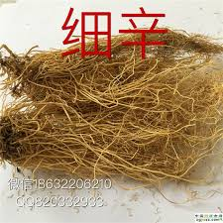
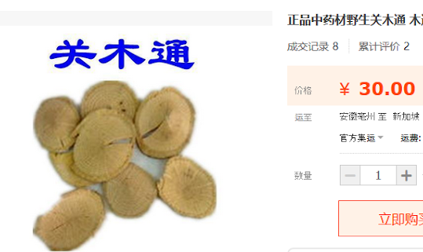
Public health: aristolochic acid (AA) AA occurs naturally in plants widely used as herbal medicine

Slide 5
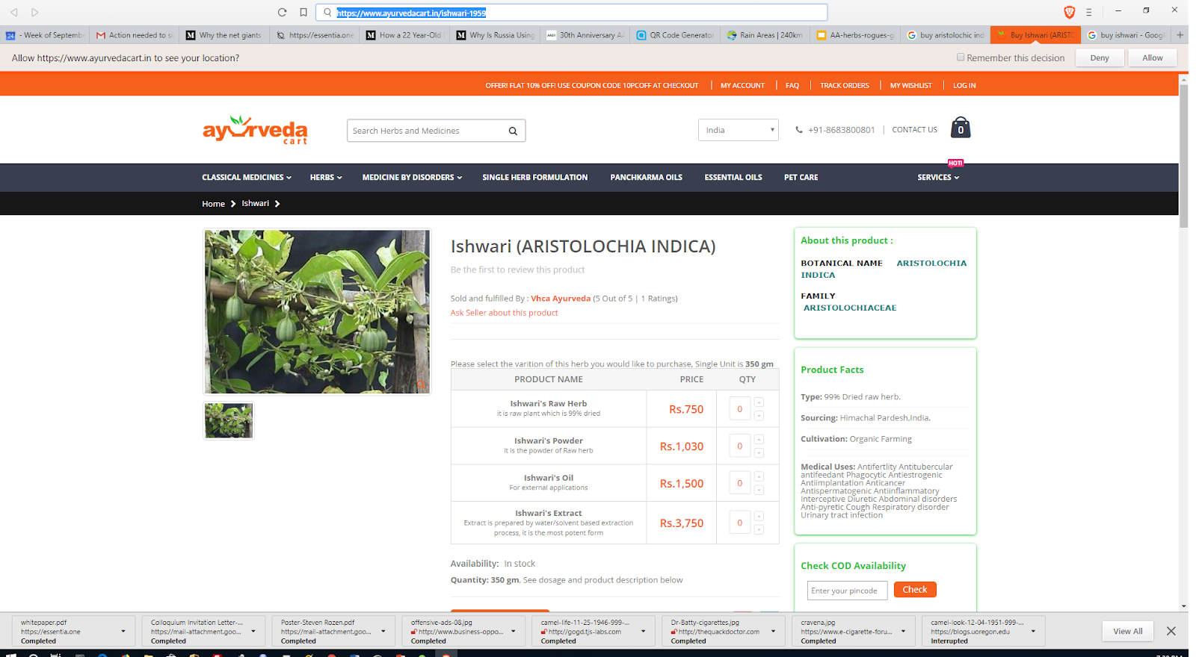
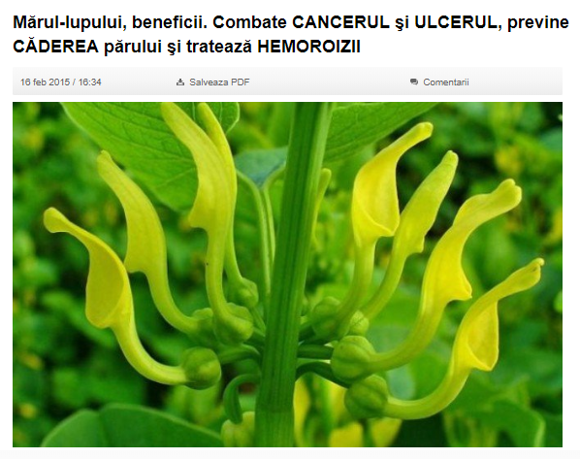
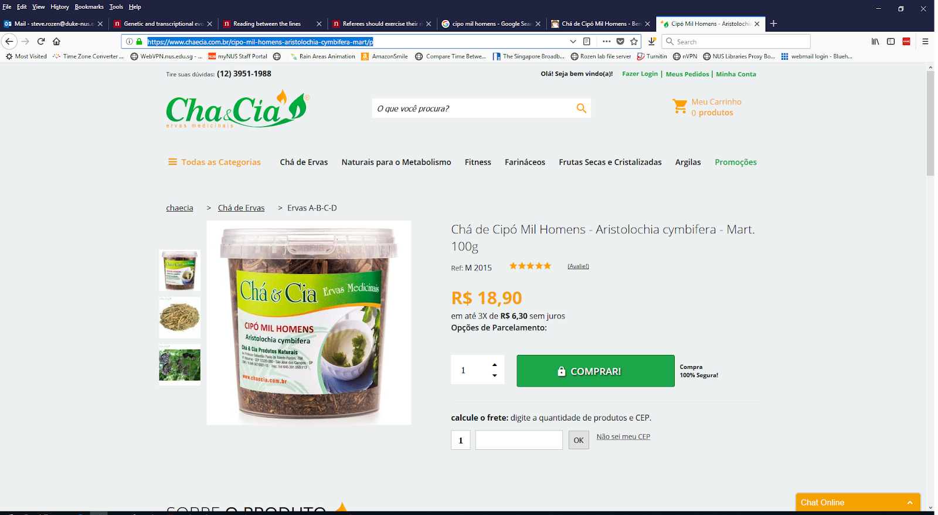
Not just Chinese herbal medicine
Romania
India
Aristolochia indica
Brazil
Aristolochia clematitis
Combats cancer, ulcers, prevents hair loss and hemorrhoids
Aristolochia cymbifera

Slide 6
1990s: AA emerged as a human health problem
~100 young women developed end stage kidney disease
Single weight-loss clinic in Europe
汉(漢)防己, hàn fáng jǐ replaced by 广(廣)防己, guǎng fáng jǐ
Notes:
Dose: (Cosyns 2003; Nortier et al. 2000)
Adducts: Nortier et al., 2000

Slide 7
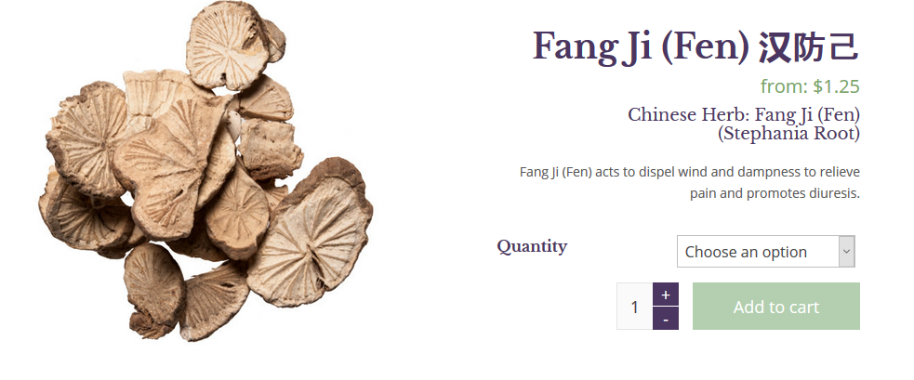
漢防己, 汉防己, hàn fáng jǐ (genus Stephania – no AA)

Slide 8
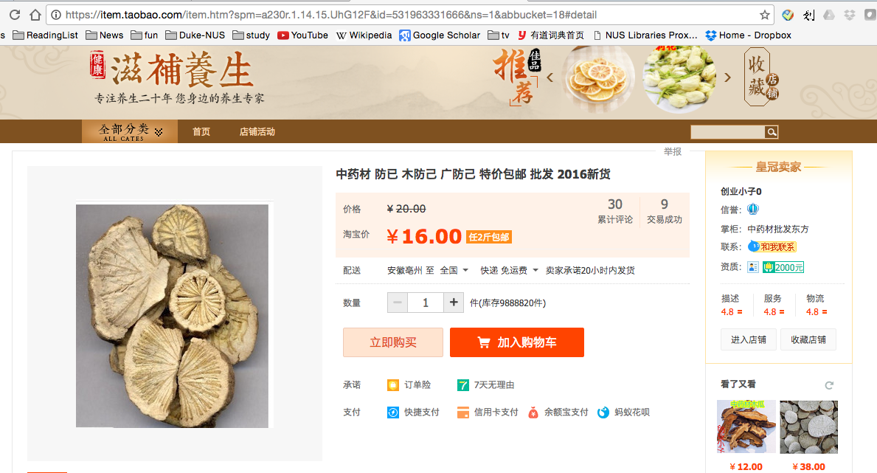
廣防己, 广防己, guǎng fáng jǐ (genus Aristolochia – has AA)
Notes:
Total of 0.5 g over average of 13 months
AA adducts

Slide 9
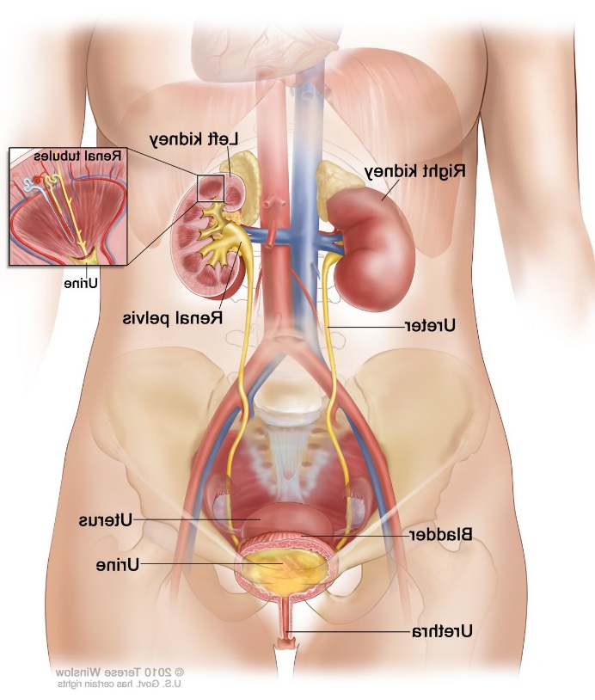
Many of the AA-kidney-failure victims developed upper tract urothelial cancer
(Nortier et al., 2000, NEJM)

Slide 10
Quick review: somatic mutations
Every time our cells divide, mutations arise
Mutations not present in the fertilized egg are somatic mutations
Our focus will be somatic mutations

Slide 11
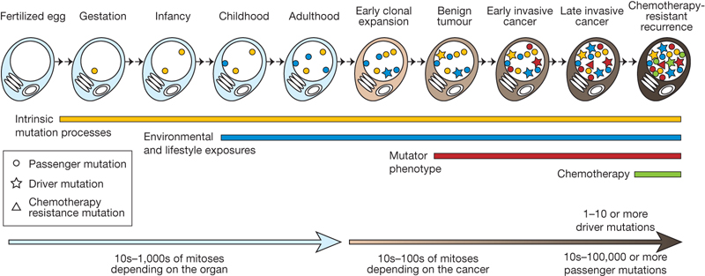
We detect somatic mutations by DNA sequencing normal cells and tumour cells
Normal
Normal
…ACGTCCTAGTCAAAATCGAGCC…

Slide 12
We detect somatic mutations by DNA sequencing normal cells and tumour cells
Normal
Tumour
…ACGTCCTAGTCAAAATCGAGCC…
…ACGTCCTAGTCTAAATCGAGCC…

Slide 13
We detect somatic mutations by DNA sequencing normal cells and tumour cells
We look for the variants found only in the tumor
Normal
Tumour
Willie Yu showed the pipeline for this last week
…ACGTCCTAGTCAAAATCGAGCC…
…ACGTCCTAGTCTAAATCGAGCC…
Somatic mutation from A > T
CAA > CTA trinucleotide context: information in neighboring bases

Slide 14
We look at all mutations (most are not causing the cancer; they are innocent bystanders)
We want to know: what mutated (changed) the DNA?
?

Slide 15
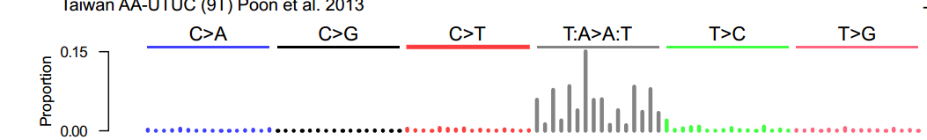
Mutational signature in an AA-exposed upper tract urothelial carcinoma
More
mutations
Each bar represents the total number of single nucleotide mutations in a particular trinucleotide context
Highest bar represents the number of CAG to CTG mutations across the entire genome
The higher the bar, the more CAG to CTG mutations
Poon et al, Science Translational Medicine, 2013

Slide 16
Mutational signature in an AA-exposed upper tract urothelial carcinoma
More
mutations
AAG > ATG mutations
Not as many
Highest bar represents the number of CAG to CTG mutations across the entire genome
The higher the bar, the more CAG to CTG mutations
Mutations from C to A, C to G, C to T
Almost none
Poon et al, Science Translational Medicine, 2013

Slide 17
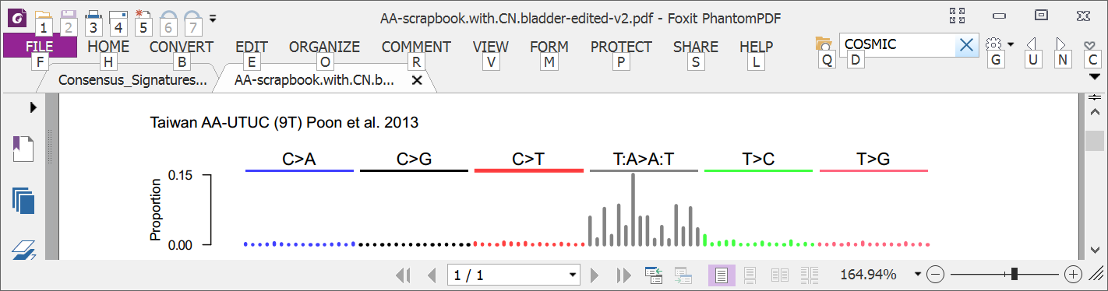
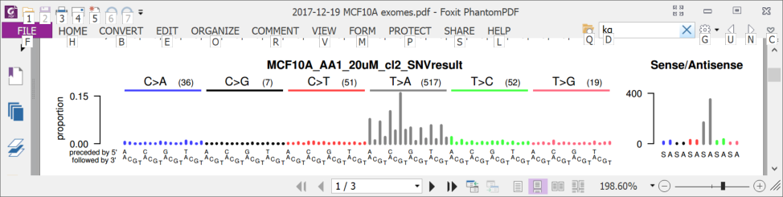
8 years ago (2013): AA in upper tract urothelial cancer and cell lines
Upper tract urothelial
AA exposed cell line
Poon et al., 2013, Hoang et al. 2013

Slide 18
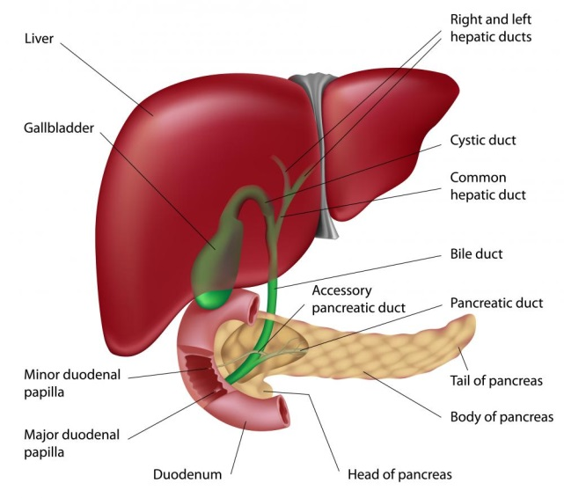
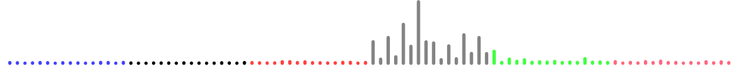
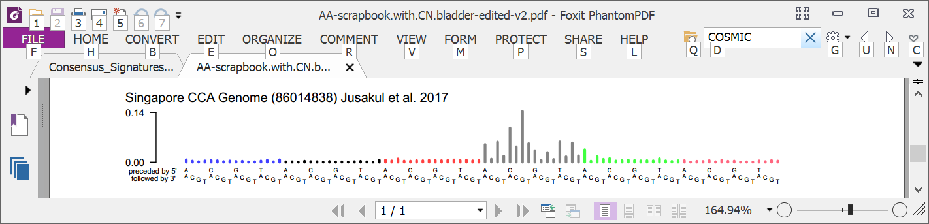
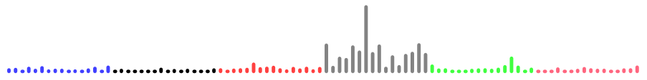
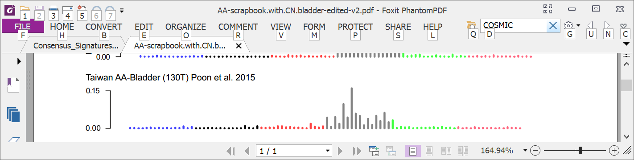
4 years ago: Mutational signatures showed AA in multiple tumor types
Liver
Bile duct
Kidney
Upper tract urothelial
Bladder
Poon et al., 2013 and subsequent data (liver - hepatocellular carcinoma [HCC])
Zou et al., 2015, Jusakul et al., 2017 (bile duct carcinoma)
Scelo et al., 2014, Jelakovic et al., 2014 (kidney/renal cell carcinoma)
Poon et al., 2013, Hoang et al., 2013, many others (upper tract urothelial carcinoma)
Poon et al., 2015, others (bladder urothelial carcinoma)

Slide 19

Taiwan a known hotspot for AA exposure but AA in liver cancer there not studied
Chen, …., Grollman, PNAS, 2012
Map created by Freepik

Slide 20
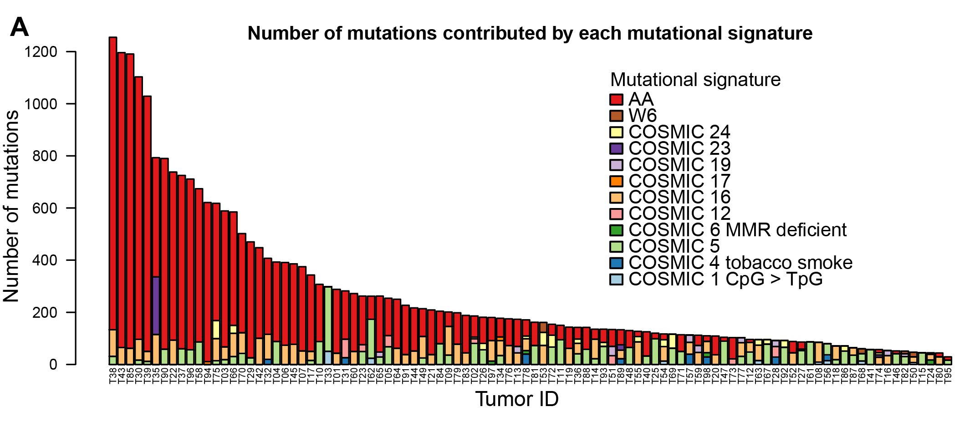
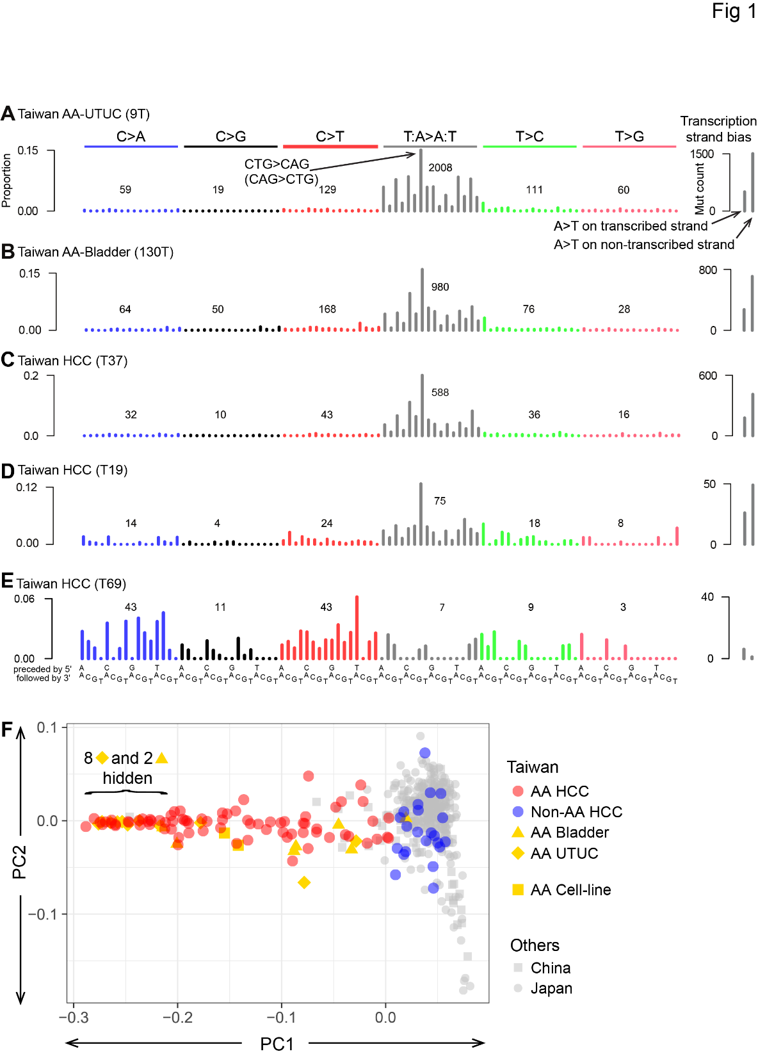
78% of Taiwan liver cancers (HCCs) had the AA signature
Ng, Poon, et al., Oct 2017 DOI: 10.1126/scitranslmed.aan6446

Slide 21
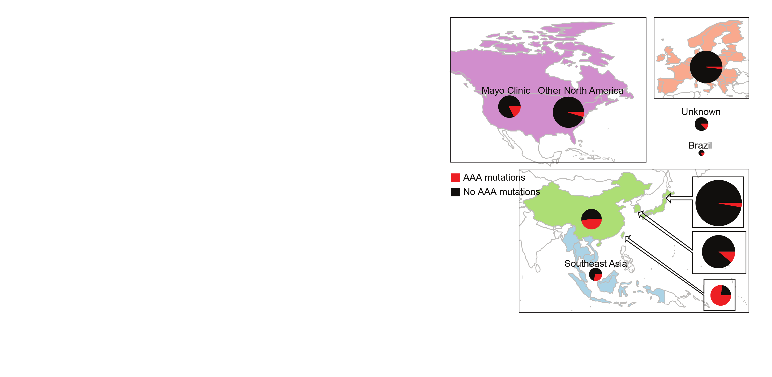

Today: 2,000 liver cancers AA exposure is prevalent
AA mutations
No AA mutations
“Asian” patients with no “country” – Overseas patients?
Ng, Poon, et al., Oct 2017 DOI: 10.1126/stranslmed.aan6446 and subsequent publications; Zhang et al., 2017, Gastroenterology, 10.1053/j.gastro.2017.03.024; Xue et al., 2019, Cancer Cell,10.1016/j.ccell.2019.04.007, 2021 Unpublished data, 2021

Slide 22
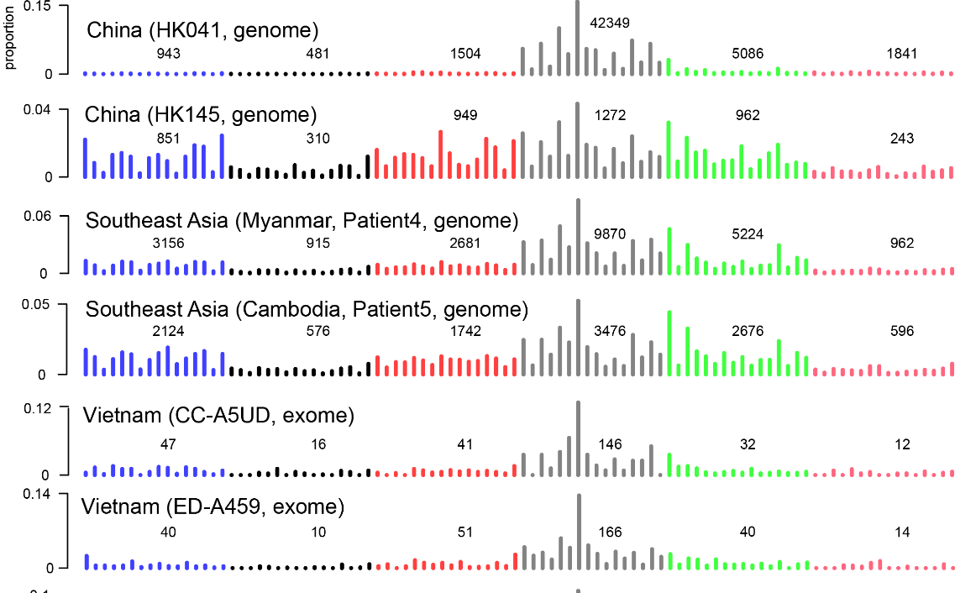

Slide 23
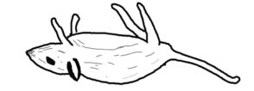
Strong evidence that AA can cause liver cancer
AA mutations
No AA mutations
Known mutagen and urinary tract carcinogen
Multiple known cancer driver genes with AA mutations
Linear relationship between AA dose and risk of liver cancer in hepatitis-B-infected and hepatitis-C-infected patients
AA causes liver cancer in mice
“Asian” patients with no “country” – Overseas patients?
Ng, Poon, et al., Oct 2017 DOI: 10.1126/stranslmed.aan6446 and subsequent publications; Zhang et al., 2017, Gastroenterology, 10.1053/j.gastro.2017.03.024; Xue et al., 2019, Cancer Cell,10.1016/j.ccell.2019.04.007; Hsieh et al., 2008, 10.1186/1749-8546-3-13; Chen et al., 2018, International Journal of Cancer, 10.1002/ijc.31544; Chen et al., 2019,Cancer Epidemiology, Biomarkers & Prevention, 10.1158/1055-9965.EPI-19-0023; Lu et al. 2019 Hepatology, 2019, 10.1002/hep.30863

Slide 24
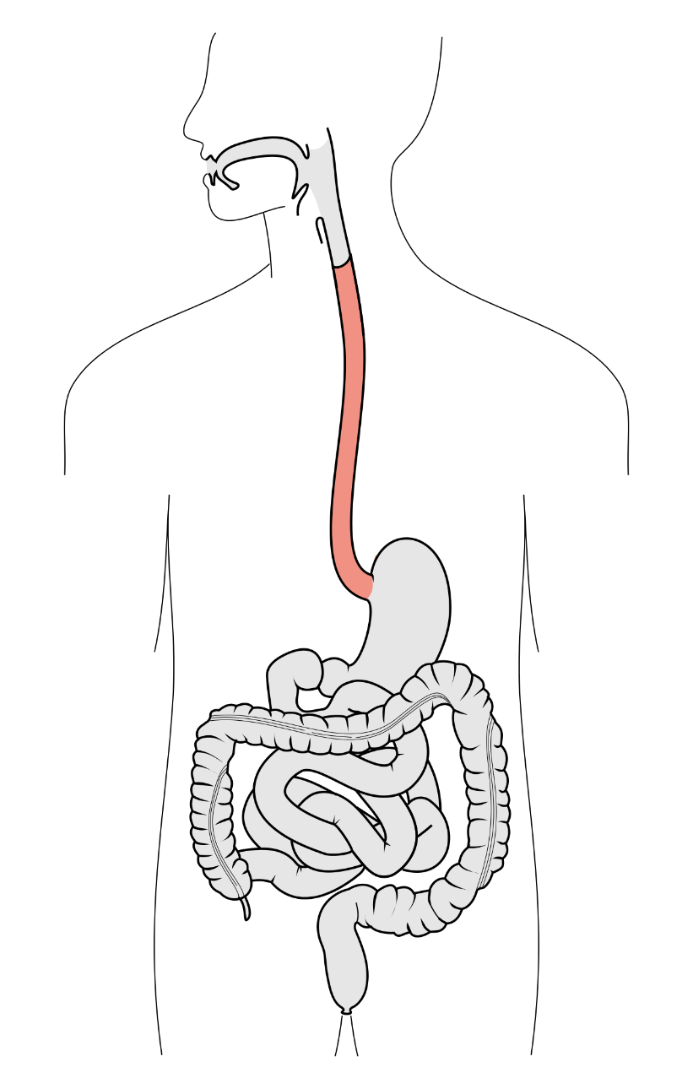
2021: Six cancer types with AA mutagenesis Strong evidence for causal roles in liver and urothelial cancers
Esophagus (squamous cell)
Liver
Bile duct
Kidney
Upper tract urothelial
Bladder
Notes:
Poon et al., 2013 and subsequent data (liver - hepatocellular carcinoma [HCC])
Zou et al., 2015, Jusakul et al., 2017 (bile duct carcinoma)
Scelo et al., 2014, Jelakovic et al., 2014 (kidney/renal cell carcinoma)
Poon et al., 2013, Hoang et al., 2013, many others (upper tract urothelial carcinoma)
Poon et al., 2015, others (bladder urothelial carcinoma)
Esophagus:
Yan et al, 2019, Nat Commun, doi: 10.1038/s41467-019-09255-1
Cui et al., 2020, Cell Research, doi: 10.1038/s41422-020-0333-6

Slide 25
Context: Aristolochic acid (AA)
Discovery
Analysis of large databases
Experimental delineation
Mutational Signatures
Molecular cancer epidemiology
Which mutational processes cause cancer?
Understanding
DNA damage & repair
Public health: prevention and screening
How do cancers develop?
Application
Therapeutic opportunities

Slide 26
Example 2: DNA damage & repair
Discovery
Analysis of large databases
Experimental delineation
DNA damage & repair experiments in yeast
Mutational signatures in cancer
Mutational Signatures
Molecular cancer epidemiology
Which mutational processes cause cancer?
Understanding
DNA damage &repair
Public health: prevention and screening
How do cancers develop?
Application
Therapeutic opportunities

Slide 27
A hotspot mutation in topoisomerase IIα (TOP2A) that causes a mutator phenotype in human cancer
Topoisomerases cut and re-join DNA strands to let them untangle or to let supercoiled duplexes unwind
One mutant in the yeast topoisomerase II gene causes duplications of 4, 3, or 2 base pairs, for example:
4 base-pair duplication CGATAC → CGATAGATAG
3 base-pair duplication ACATG → ACATCATG
2 base-pair duplication CATG → CATATG
Stantial, https://doi.org/10.1073/pnas.2008721117 PNAS 2020

Slide 28
This matched ID17 ID17 is an indel (insertion/deletion) mutational signature discovered by mining cancer mutation data
E.g. ACATG → ACATCATG
(3 base-pair duplication)
E.g. CGATAC → CGATAGATAG
(4 base-pair duplication)
E.g. CATG → CATATG
(2 base-pair duplication)

Slide 29
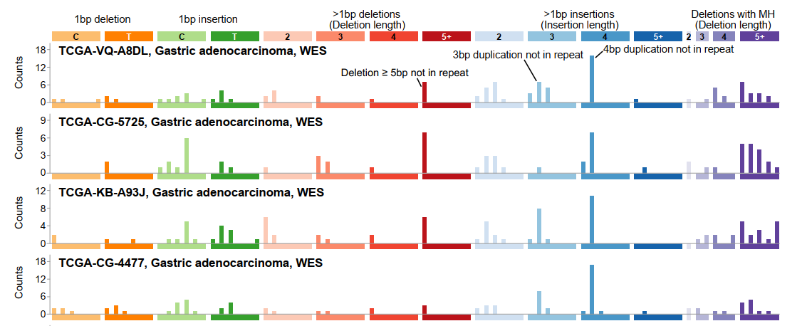
ID17 was in 4 stomach cancers
E.g. ACATG → ACATCATG
(3 base-pair duplication)
E.g. CGATAC → CGATAGATAG
(4 base-pair duplication)
E.g. CATG → CATATG
(2 base-pair duplication)

Slide 30
We then found 3 other tumors with ID17 Average spectrum of tumors with ID17:
E.g. ACATG → ACATCATG
(3 base-pair duplication)
E.g. CGATAC → CGATAGATAG
(4 base-pair duplication)
E.g. CATG → CATATG
(2 base-pair duplication)
Notes:
Bars are SEM

Slide 31
All 7 tumors had identical mutations in a human ortholog of yeast Top2
Lysine to asparagine at residue 743 in topoisomerase II alpha: TOP2A p.K743N
Among > 12,000 tumors (Alexandrov, 2020), only the 4 stomach cancers had K743N, and no other tumor had the ID17 duplication signature
Very strong association between the K743N mutation and the associated signature (P < 10⁻¹⁴)

Slide 32
But besides the ID17 duplications, K743N tumors also have deletions that are not in ID17
E.g. ACATG → ACATCATG
(3 base-pair duplication)
E.g. CGATAC → CGATAGATAG
(4 base-pair duplication)
E.g. CATG → CATATG
(2 base-pair duplication)
Deletions of 5 or more base pairs
For example
ACTACAGGT → ACGT
ACTACAGGT → AT
Deletions of 5 or more base pairs
with “microhomology”, For example
ACTACACTAG → ACTAG
ACTACAGGCA → ACA

Slide 33
These deletions resemble another signature, ID8, previously discovered by data mining
Deletions of 5 or more base pairs
For example
ACTACAGGT → ACGT
ACTACAGGT → AT
Deletions of 5 or more base pairs
with “microhomology”, For example
ACTACACTAG → ACTAG
ACTACAGGCA → ACA

Slide 34
These deletions resemble another signature, ID8, previously inferred by data mining
ID8 is common
Could these deletions in K743N tumors be caused by the same process that causes ID8?
Or are these deletions due to K743N ?
Deletions of 5 or more base pairs
For example
ACTACAGGT → ACGT
ACTACAGGT → AT
Deletions of 5 or more base pairs
with “microhomology”, For example
ACTACACTAG → ACTAG
ACTACAGGCA → ACA

Slide 35
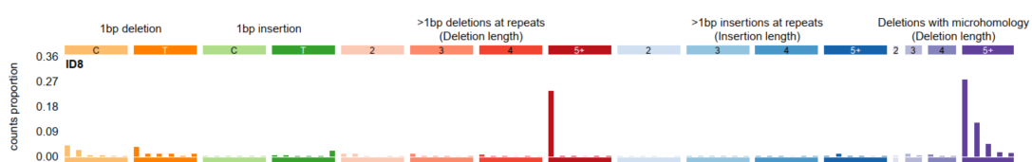
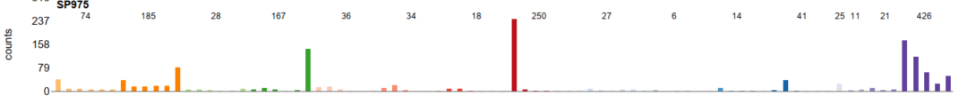
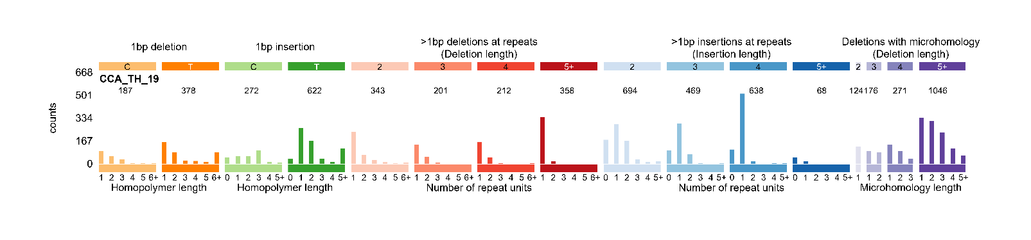
K743N tumors and ID8 tumors have different distributions of deletion sizes
ID8 signature
Deletions of 2, 3, and 4 base pairs are much more common in K743N tumors
ID8 dominated tumor
K743N tumor

Slide 36
K743N tumors and ID8 tumors have different distributions of the sizes of larger deletions
Deletions of 6, 7, and 8 base pairs are much more common in K743N tumors
Differences in size distribution suggest that many or most of these deletions in K743N tumors are caused by the K743N mutation, not by the ID8 process
Red lines are K743N tumors
Deletions > 15 base pairs are rarer in K743N tumors
Tumors dominated by ID8 and
ID6 (MSI)

Slide 37
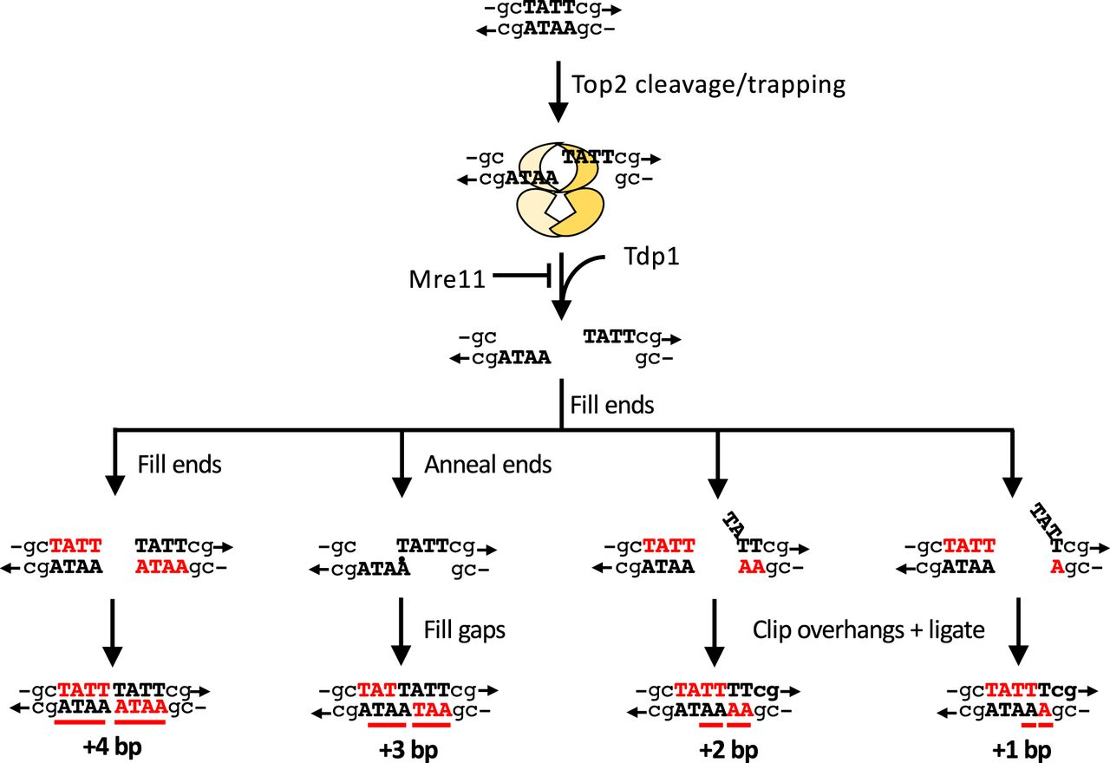
DNA damage & repair perspective
Yeast and in-vitro experiments show that the duplication signature in yeast Top2 mutants occurs because the mutated Top2 cannot re-ligate after nicking

Slide 38
DNA damage & repair perspective
Yeast and in-vitro experiments show that the duplication signature in yeast Top2 mutants occurs because the mutated Top2 cannot re-ligate after nicking
We think duplications arise from repair of these nicks that Top2 was not able to re-ligate
Non-homologous end joining is required for repair
Sue Jinks-Robertson
Nicole Stantial
Clip ends
Clip overhang
Ligate
Ligate

Slide 39
DNA damage & repair perspective
We think duplications due to human TOP2A K743N arise from the same processes as duplications due to yeast Top2 mutants
Human K43N tumors have deletions that yeast Top2 mutants do not have
Hypothesis: deletions due to human TOP2A K743N stem from repair by theta-mediated end joining – a pathway yeast do not have
E.g. ACATG → ACATCATG
(3 base-pair duplication)
E.g. CGATAC → CGATAGATAG
(4 base-pair duplication)
E.g. CATG → CATATG
(2 base-pair duplication)
Deletions of ≥ 2 base pairs,
with microhomology
Deletions of ≥ 2 base pairs

Slide 40
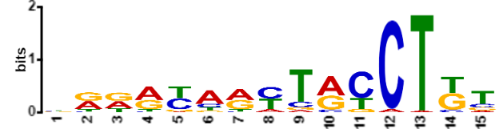
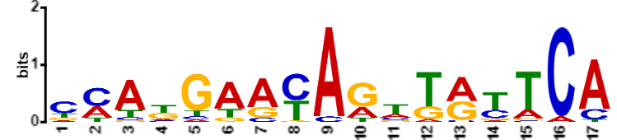
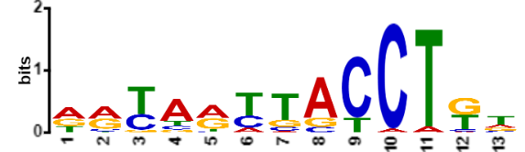
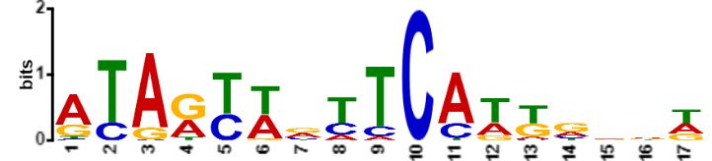
2 sequence motifs associated with duplications and deletions in K743N tumors
K743N type 1
K743N type 2
Duplications
Deletions

Slide 41
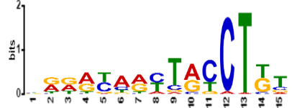

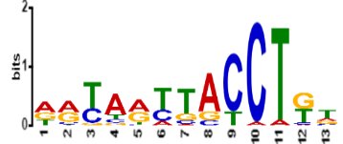

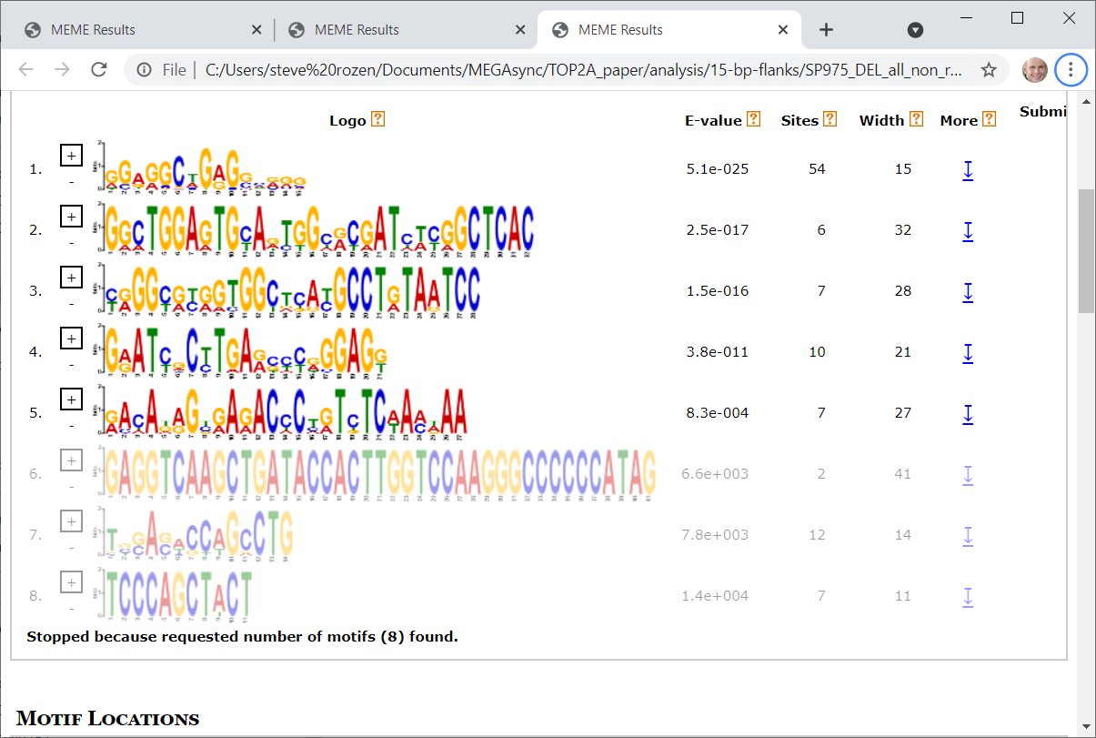
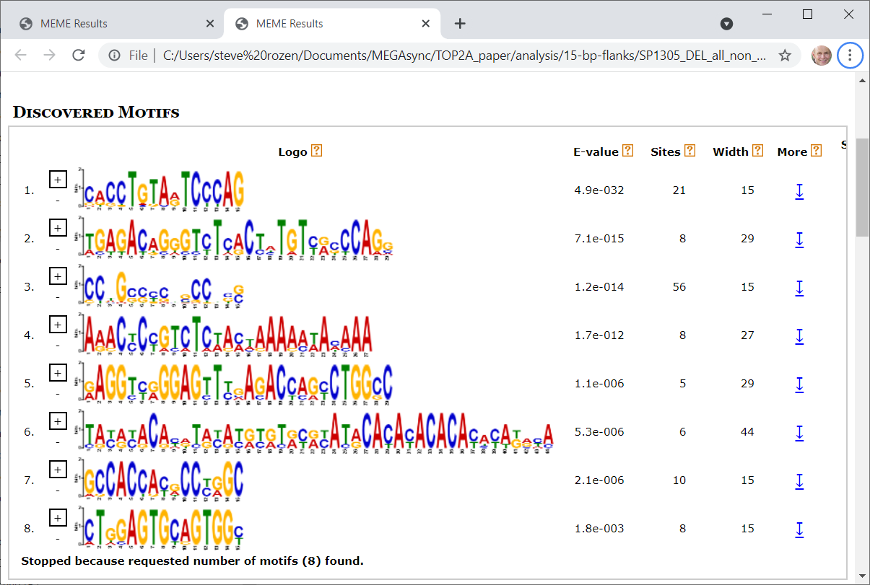
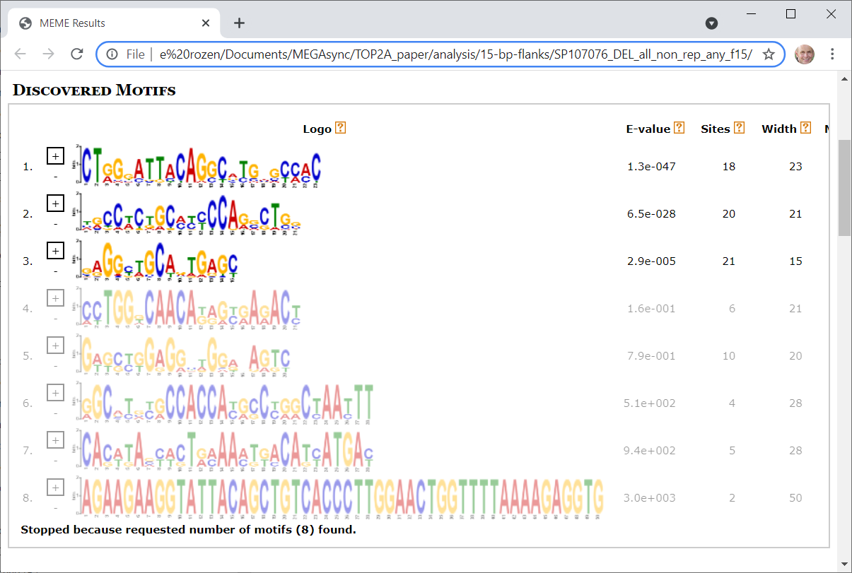
K743N motifs not detected in ID8-dominated tumors
K743N duplication and deletion motifs
Motifs at ID8 deletions in ID8-dominated tumors
Further evidence that many or most of these deletions in K743N tumors are caused by K743N, not by the process that causes ID8

Slide 42
K743N and oncogenesis
6 of the 7 K743N tumors had presumably inactivating frameshift indels in PTEN or TP53 that were probably due to K743N
Known oncogenic deletion in BRAF
One or both K743N sequence motifs were present at each of these sites
In total, K743N tumors had 45 indels in COSMIC cancer driver genes
One or both K743N sequence motifs were present at 35 of the 45 indels
Odds ratio for enrichment vs PCAWG tumors = 177, p < 10⁻⁴⁷

Slide 43
Summary AA and TOP2A p.K743N
Discovery
Analysis of large databases
Experimental delineation
Mutational Signatures
TOP2A p.K743N
Molecular cancer epidemiology
Which mutational processes cause cancer?
Understanding
DNA damage & repair
AA
Public health: prevention and screening
How do cancers develop?
Application
AA
Therapeutic opportunities

Slide 44
Computation for mutational signatures

Slide 45
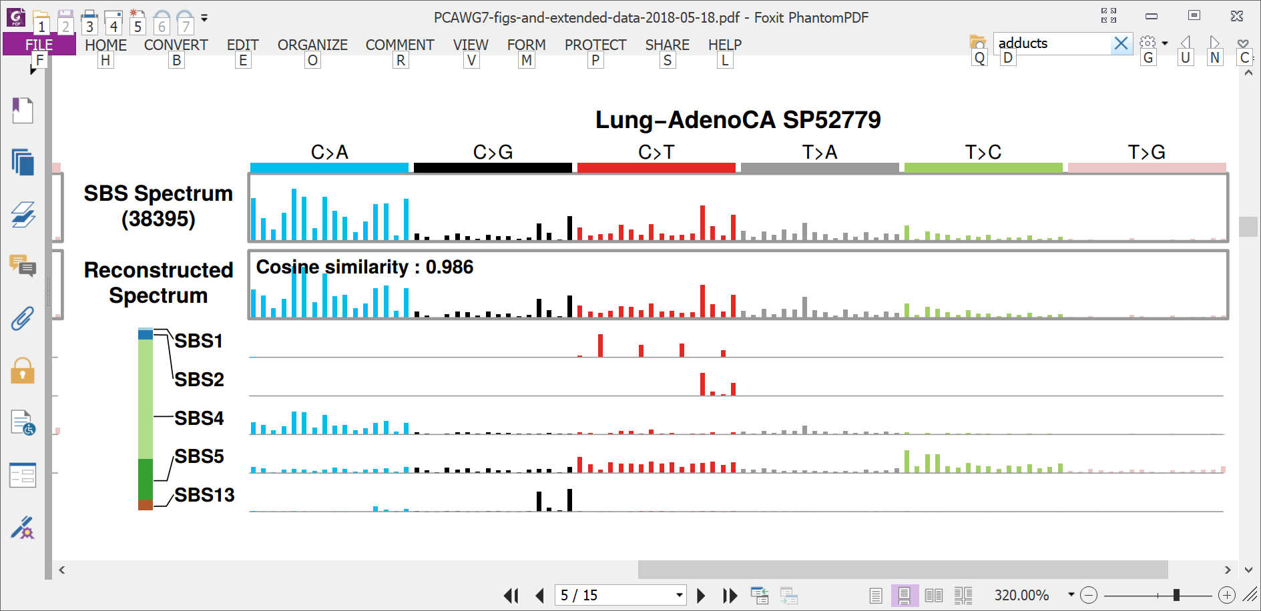
More often, spectra consist of superimposed mutations from multiple processes
Spectrum:
39,000 mutations

Slide 46
More often, spectra consist of superimposed mutations from multiple processes
Spectrum:
39,000 mutations
Counts of mutations due to 5 signatures

Slide 47
More often, spectra consist of superimposed mutations from multiple processes
Spectrum:
39,000 mutations
Counts of mutations due to 5 signatures

Slide 48
More often, spectra consist of superimposed mutations from multiple processes
Spectrum:
39,000 mutations
Counts of mutations due to 5 signatures

Slide 49
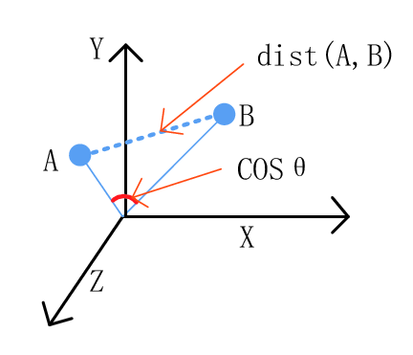
Cosine similarity versus Euclidean distance
Consider the signature to be a vector in 96-dimensional space
Figure from 10.3390/info8040140 Wang, Chen, Wu, 2017

Slide 50
What questions do we want to answer?
“Extraction” / Discovery Given a large number of spectra, what mutational signatures are present? (I.e. mutational signatures are latent variables to be discovered.) And how many mutations are caused by each extracted signature in each spectrum? (“Attribution”)
“Attribution only” Given known mutational signatures and one or more spectra, how many mutations in each spectrum were caused by each signature?
“Signature presence test” Given known mutational signatures, what is the evidence that a signature of interest is present in a spectrum?

Slide 51

What questions do we want to answer?
“Extraction” / Discovery Given a large number of spectra, what mutational signatures are present? (I.e. mutational signatures are latent variables to be discovered.) And how many mutations are caused by each extracted signature in each spectrum? (“Attribution”)
“Attribution only” Given known mutational signatures and one or more spectra, how many mutations in each spectrum were caused by each signature?
“Signature presence test” Given known mutational signatures, what is the evidence that a signature of interest is present in a spectrum?

Slide 52
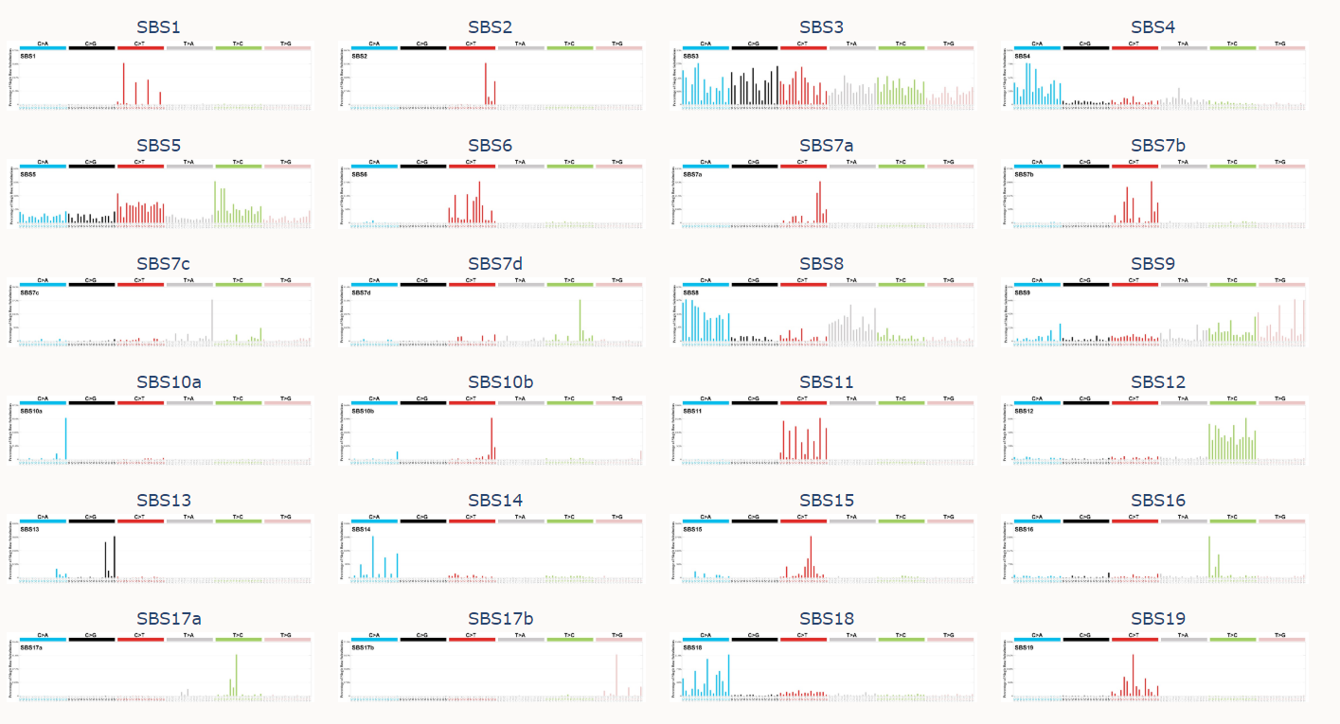
Many signatures have been extracted and many have been confirmed by additional evidence
…
and many more
https://cancer.sanger.ac.uk/cosmic/signatures/index.tt from Alexandrov, L.B., Kim, J., Haradhvala, N.J. et al. The repertoire of mutational signatures in human cancer. Nature 578, 94–101 (2020) https://doi.org/10.1038/s41586-020-1943-3

Slide 53
Data mining can tease apart signatures in large sets of spectra
There are approaches based on:
Non-negative-matrix-factorization (NMF)
Probabilistic topic models
(will not discuss, see Nicola Roberts’ thesis https://www.repository.cam.ac.uk/handle/1810/275454 and https://github.com/steverozen/mSigHdp )
Unsupervised machine learning
All methods seem to face similar challenges
Signature discovery is not a purely algorithmic process
The granularity of extracted signatures and the type of mutations considered depend on the larger questions you are considering

Slide 54
Many techniques for extraction are based on non-negative matrix factorization (NMF)
Each cell contains level of exposure of 1 tumor to 1 signature
23,000 tumors
W
X
H
N
signatures
96 mutation types
23,000 tumors
N
signatures
≈
V (observed mutations)
96 mutation types

Slide 55
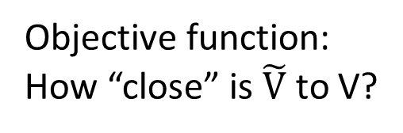

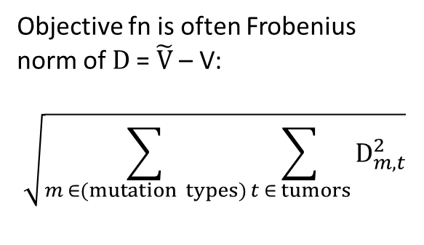
Many techniques for mutational signature extraction are based on non-negative matrix factorization (NMF)
Each cell contains level of exposure of 1 tumor to 1 signature
Objective fn is often Frobenius norm of D = $\tilde{V}$ – V:
$$\sqrt{\sum_{m ∈(mutation types)}{\sum_{t ∈ tumors}{D_{m,t}^{2}}}}$$
23,000 tumors
W
X
H
N
signatures
96 mutation types
23,000 tumors
N
signatures
=
$\tilde{V}$ = W x H
96 mutation types
Objective function:
How “close” is $\tilde{V}$ to V?
≈
V (observed mutations)

Slide 56
General observations on NMF
NMF is a collection of algorithms and techniques
The best approximate factorization depends on the objective function
As for many unsupervised learning approaches, determining the number of items (signatures) to discover is challenging
Need to avoid overfitting (so often do multiple factorizations on e.g. bootstrapped data)

Slide 57
NMF example: SigProfilerExtractor
Supersedes the MATLAB code used in Alexandrov 2013 and 2020
Latest release: https://pypi.org/project/sigproextractor/
https://github.com/AlexandrovLab
Documentation at https://osf.io/t6j7u/wiki/3.%20Using%20the%20Tool%20-%20Output/
More info in Alexandrov et al 2013 and 2020:
http://dx.doi.org/10.1016/j.celrep.2012.12.008
https://doi.org/10.1038/s41586-020-1943-3

Slide 58
SigProfilerExtractor runs NMFs over multiple iterations of bootstrapped data
Purpose, to avoid overfitting
Multinomial resampling of counts for mutation types (e.g. ACA > AAA, ACC > AAC, … TTT > TGT) for each tumor based on the observed total mutation count in the tumor and the proportion of counts of each mutation type.
Recommends 100; user smaller number for initial testing
Recommend to run several times with different seeds; if solutions are different, run more NMF iterations
More info in Alexandrov et al 2013 and 2020:
http://dx.doi.org/10.1016/j.celrep.2012.12.008
https://doi.org/10.1038/s41586-020-1943-3

Slide 59
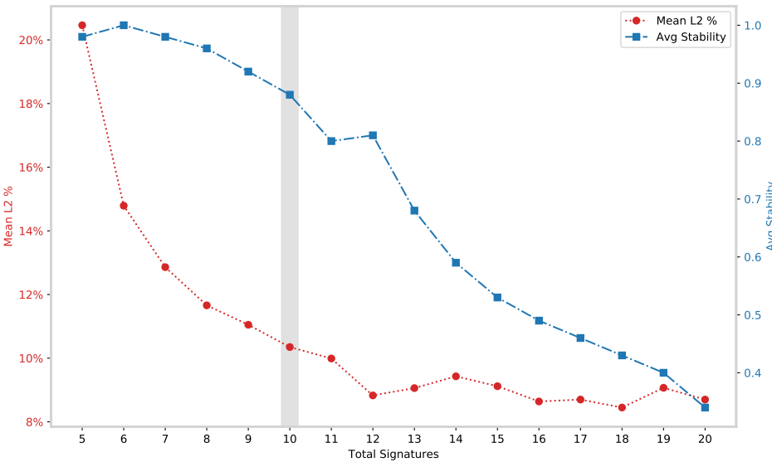
SigProfilerExtractor: Selecting the number of signatures
Mean L2% is the average across samples of the percent Euclidian reconstruction error (low is good)
Average stability is the mean across NMF iterations of silhouette coefficient of the clusters of proto-signatures (indicates how well the proto-signatures are clustered into signatures – high is good)

Slide 60
Known issues with approaches based on non-negative matrix factorization (NMF)
The number of signatures is a judgement call (some approaches deal with this)
Weak signatures cannot be discovered in background of strong signatures
Signatures can be imperfectly separated (“bleeding” and “stealing” between signatures)
More generally, recovered signatures depend strongly on exact set of tumours studied
Lowest error reconstruction often involves many signatures, some with very low contributions, and often not biologically plausible (see following slides)
Signature discovery (extraction) is not a purely algorithmic process
In practice, discovering signatures (“extraction”) needs to be separated from estimating exposures (“attribution”)
!

Slide 61
Sparsity and plausibility
Signatures that, when combined, give the most accurate reconstruction of a spectrum are the best ones
Adding more signatures in tiny amounts usually improves reconstruction even if activity of signatures is biologically implausible
Not useful for deciding if a mutational signature is present to a biologically meaningful extent

Slide 62
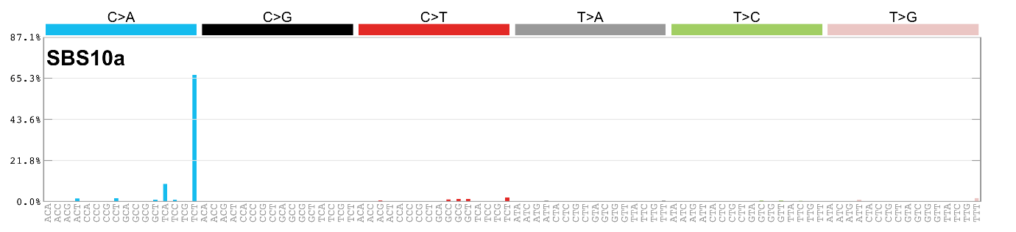
Extreme example:
A set of 96 signatures, each of one single base substitution in trinucleotide context will yield perfect reconstruction and zero biological insight

Slide 63
Signature discovery is not a purely algorithmic process: How to assess results (1)
The input data have been examined for sequencing and mapping artifacts (some which are well-known); mapped reads supporting unusual patterns have been examined in a read-alignment viewer or have been experimentally verified
Look for external supporting evidence
Correlation with known or expected mutagenic exposures, eg
cigarette smoking
Aflatoxins
AA-containing herbs
Haloalkanes
Age
UV radiation
Correlation with known or expected genetic causes, eg
polymerase epsilon proofreading defects
mismatch repair deficiency
homologous recombination repair deficiency (BRCA)
Can be tied to known biochemical processes (eg guanine adducts and signatures with C:G > N:N mutations)

Slide 64
Signature discovery is not a purely algorithmic process: How to assess results (2)
Association with genomic features that interact with DNA repair
Transcription strand bias
Replication strand / timing
Homopolymers (indels)
Look for supporting evidence within the data set
Samples dominated by a single signature
Signature is consistently deciphered from multiple independent datasets using different techniques or hyperparameters
Absence of known problems (next slides)
More info at https://static-content.springer.com/esm/art%3A10.1038%2Fs41586-020-1943-3/MediaObjects/41586_2020_1943_MOESM4_ESM.pdf, pages 6 & 7
Look for known issues with signature discovery

Slide 65
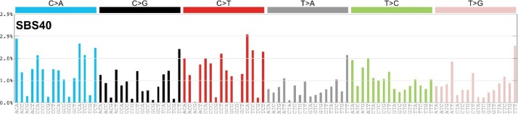
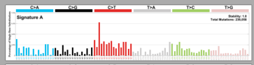

Known problems: bleeding
Ground truth (synthetic data)
Extracted
“Bleeding” or incomplete separation of some CG > TG mutations from SBS1 to SBS40-like extracted signature
65

Slide 66


Known problem: over-splitting (from a different synthetic data set)
+
2 extracted signatures
≈
1 ground-truth signature

Slide 67
Outline
What are mutational signatures and what are they good for?
Computational analysis of mutational signatures – state of the art
Important unsolved problems in mutational signature analysis
Summary

Slide 68
What questions do we want to answer?
“Extraction” / Discovery Given a large number of spectra, what mutational signatures are present? (I.e. mutational signatures are latent variables to be discovered.) And how many mutations are caused by each extracted signature in each spectrum? (“Attribution”)
“Attribution only” Given known mutational signatures and one or more spectra, how many mutations in each spectrum were caused by each signature?
“Signature presence test” Given known mutational signatures, what is the evidence that a signature of interest is present in a spectrum?

Slide 69
What questions do we want to answer?
D
“Extraction” / Discovery Given a large number of spectra, what mutational signatures are present? (I.e. mutational signatures are latent variables to be discovered.) And how many mutations are caused by each extracted signature in each spectrum? (“Attribution”)
“Attribution only” Given known mutational signatures and one or more spectra, how many mutations in each spectrum were caused by each signature?
“Signature presence test” Given known mutational signatures, what is the evidence that a signature of interest is present in a spectrum?

Slide 70

Signature presence test
?
Is the AA signature present?
Example, motivated by our study of AA exposure in liver cancer
Was this tumour exposed to AA?

Slide 71
Signature presence test
Best reconstruction without AA
Log likelihood of reconstruction -1040

Slide 72
Signature presence test
Best reconstruction without AA
The likelihood of the reconstruction is the probability that negative binomial resampling from the reconstruction yields the spectrum
Log likelihood of reconstruction -1040

Slide 73
Signature presence test
Best reconstruction WITH AA
Best reconstruction without AA
Log likelihood of reconstruction -1021
Log likelihood of reconstruction -1040

Slide 74
Signature presence test
Best reconstruction WITH AA
Best reconstruction without AA
Likelihood ratio test
p < 10⁻⁹
Note that we have added a statistical concept
Log likelihood of reconstruction -1021
Log likelihood of reconstruction -1040

Slide 75
We reject the null hypothesis that the reconstruction of the spectrum without the AA signature is as good as the reconstruction with the AA signature That is, we need the AA signature to plausibly explain the spectrum

Slide 76
Importance of benchmarking

Slide 77

2 signatures in differing combinations

Slide 78

Cosine similarity to SBS1 and SBS5

Slide 79
Positive predictive value and true positive rate

Slide 80

Some software seems not to have been tested: this one extracted duplicate signatures

Slide 81


Some software seems not to have been tested: some had radically different results with different random seeds

Slide 82

This one almost always got the same result

Slide 83
What questions do we want to answer?
“Extraction” / Discovery Given a large number of spectra, what mutational signatures are present? (I.e. mutational signatures are latent variables to be discovered.) And how many mutations are caused by each extracted signature in each spectrum? (“Attribution”)
“Attribution only” Given known mutational signatures and one or more spectra, how many mutations in each spectrum were caused by each signature?
“Signature presence test” Given known mutational signatures, what is the evidence that a signature of interest is present in a spectrum?

Slide 84

Internal testing of methods for attribution

Slide 85
Cheat sheet
F₁ = 2 (recall-¹ + precision⁻¹)⁻¹ = TP (TP + 0.5(FP + FN))⁻¹
Recall = True Positive Rate = sensitivity = 1 – false negative rate
Precision = Positive predictive value (PPV)
= (True positive)(predicted positive)⁻¹

Slide 86

When in doubt refer to https://en.wikipedia.org/wiki/F-score

Slide 87

Internal testing of methods for attribution (indels, realistic noise)

Slide 88

Internal testing of methods for attribution (indels, realistic noise)

Slide 89
Acknowledgements for AA in Liver Cancer
Chang Gung Memorial Hospital
Sen-Yung Hsieh (谢森永)
Hao-Yi Huang
Ming-Chin Yu
Po-Huang Lee
Jacob See-Tong Pang
Singapore (Duke NUS, National Cancer Centre Singapore, and Johns Hopkins Singapore)
Arnoud Boot
Alvin NG Wei Tian (黄伟添)
Song Ling POON
Mi Ni HUANG
Jing Quan LIM
Nanhai Jiang
Shenli Zhang
Szu-Chi Ho
Willie Yu
Yuka Suzuki
Cedric C. Y. Ng
Patrick Tan
Bin Tean TEH
Alex Chang
Funding
Singapore National Medical Research Council
Singapore Ministry of Health via the Duke-NUS Signature Research Programmes
Chang Gung Medical Foundation
https://tinyurl.com/aa-liver-cancer

Slide 90
General acknowledgements
The International Cancer Genome and The Cancer Genome Atlas Pan-Cancer Analysis of Whole Genomes Consortium (PCAWG)
The PCAWG Mutational Signatures Analysis Working Group
Co-lead Mike Stratton, many contributors including Ludmil Alexandrov, Jaegil Kim, Gaddy Getz, Nick Haradhvala, and many many others, see https://doi.org/10.1038/s41586-020-1943-3
My lab
Arnoud Boot, Szu-Chi HO, Mini Huang, Nanhai Jiang, John McPherson, LIU Mo, Alvin Wei Tian Ng, WU Yang, Willie Yu, Shenli Zhang

Slide 91

Caution: Conceptual Hazard These analytical tools are not oracles They do not algorithmically reveal a Platonic truth Their analyses need to be assessed by humans in the light of all available evidence

Slide 92
“All models are wrong but some are useful”
George E. P. Box (1979), "Robustness in the strategy of scientific model building", in Launer & Wilkinson, Robustness in Statistics
I hope you will find some of these models useful
More research is needed!
Thank you and questions?
steverozen@gmail.com
92

Slide 93
Backup Slides

Slide 94

M. Heinrich et al 2009
doi:10.1016/j.jep.2009.05.028

Slide 95


AA causes liver cancer in mice
** or * indicate
significant
versus untreated
The mutational features of aristolochic acid-induced mouse and human liver cancers
Zhao-Ning Lu, Qing Luo, Li-Nan Zhao, Yi Shi, Xian-Bin Su,
Ze-Guang Han
doi: https://doi.org/10.1101/507301
Dec 28, 2018
Months after exposure
7.5 15 35 70
Total dose (mg/kg)
(Re-drawn from Lu et al.)

